Slide 1
AI-Driven Voice-Based Healthcare Framework
Harsha Vardhan Kosuru
12210058

Slide 2
Introduction
Advances in Artificial Intelligence (AI), speech processing, and cloud technologies are transforming digital healthcare. Traditional healthcare systems often face issues such as limited accessibility, long waiting times, and restricted interaction between patients and doctors. Telemedicine platforms improved access but still rely mostly on text chats or video consultations, which do not fully capture natural communication or detailed health information.
The AI-Driven Voice-Based Healthcare Framework improves telemedicine by enabling patients to communicate naturally through voice. The AI system listens, analyzes symptoms, asks follow-up questions, and generates structured medical reports automatically. This approach combines conversational AI, cloud computing, and healthcare automation to provide accessible and personalized digital healthcare support.

Slide 3
Problem Statement
Existing telemedicine solutions often lack natural interaction and structured medical data collection. Patients must manually describe symptoms through text or short video consultations, which can lead to incomplete or unclear medical information. There is also limited automation in generating consultation summaries or reports, leading to inefficiencies and longer consultation times.

Slide 4
Motivation
Healthcare accessibility remains a challenge, especially in rural or underserved areas. Many patients lack quick access to doctors and hesitate to visit hospitals for minor issues. Automated voice-based healthcare assistance can provide preliminary support, reduce consultation load, and help users receive immediate guidance. This motivates the creation of an intelligent, voice-driven healthcare assistant.

Slide 5
Objectives
Develop a voice-based AI system capable of doctor-like consultation.
Automatically extract symptoms and generate structured medical reports.
Improve healthcare accessibility through remote consultation support.
Provide real-time symptom monitoring and predictive insights.
Ensure secure and privacy-aware medical data handling.
Reduce doctor workload through automated data summarization.

Slide 6
Literature Review
Evolution of Digital Healthcare Systems
Digital healthcare solutions have grown rapidly due to advancements in AI and cloud computing. Telemedicine platforms expanded significantly during global health emergencies, demonstrating the importance of remote healthcare solutions. However, many systems still lack intelligent conversational interaction.

Slide 7
Voice Interaction in Healthcare
Voice-based AI systems and virtual assistants have improved accessibility across industries. Voice interaction allows users to communicate naturally without typing, making technology easier to use for elderly patients and those with limited technical skills.

Slide 8
Existing Healthcare Chatbots
Current healthcare chatbots assist users through rule-based symptom questionnaires. While helpful, these systems often lack intelligent conversation handling and fail to produce structured consultation summaries for future medical use.

Slide 9
Limitations of Current Systems
Existing digital healthcare solutions suffer from limited personalization, inability to maintain conversation context, scalability issues during peak usage, and challenges in maintaining patient data privacy and security. Many systems also lack predictive analysis features.

Slide 10
Research Gap Identified
Literature analysis shows that few systems integrate voice-based consultation, automated report generation, predictive monitoring, and scalable architecture into a single solution. This gap motivates the development of the proposed intelligent framework.

Slide 11
Contribution of Proposed Framework
The proposed system introduces a voice-enabled AI healthcare assistant capable of real-time consultation, automated medical documentation, predictive symptom monitoring, secure data management, and scalable deployment, addressing limitations identified in previous research.

Slide 12
Research Paper Analysis
Literature Survey Overview
An extensive literature review was performed using approximately 50 research papers collected from IEEE Xplore, ResearchGate, NCBI, and healthcare technology journals. These papers covered conversational AI, telemedicine systems, virtual assistants, and automated healthcare solutions.

Slide 13
Selection of Top Research Papers
From the collected research pool, 20 high-quality Scopus and SCI-indexed papers were selected based on relevance, citation impact, and technical contribution. These papers provided strong foundations for system design and research direction.

Slide 14
Key Observations from Literature
Literature findings demonstrate that conversational AI improves patient engagement, automation reduces doctor workload, and voice-based interaction increases usability. However, integration challenges remain in healthcare applications.
Gap Summary and Justification
Existing healthcare systems rarely combine conversational AI, structured report automation, and predictive monitoring in a unified framework, validating the need for the proposed system.

Slide 15
Methodology & Implementation
System Methodology Workflow
The methodology involves user login, voice consultation initiation, speech-to-text conversion, AI-based symptom analysis, follow-up questioning, report generation, and secure storage of consultation records.

Slide 16
System Architecture Overview
The architecture includes frontend interaction layer, backend processing services, speech recognition engine, AI reasoning module, database storage, and authentication services working together to ensure smooth consultation flow.
Implementation Technologies Used
Technologies used include Next.js and React for frontend development, AssemblyAI for speech recognition, Vapi.ai for conversational voice interaction, Neon PostgreSQL for database storage, Clerk for authentication management, and cloud deployment services.

Slide 17
System Interface Demonstration
System components such as login interface, consultation dashboard, voice interaction screen, generated medical report, and consultation history view.
Key System Features
Major features include natural voice consultation, automated report generation, predictive health alerts, secure data storage, scalable architecture, and continuous symptom monitoring capabilities.

Slide 18
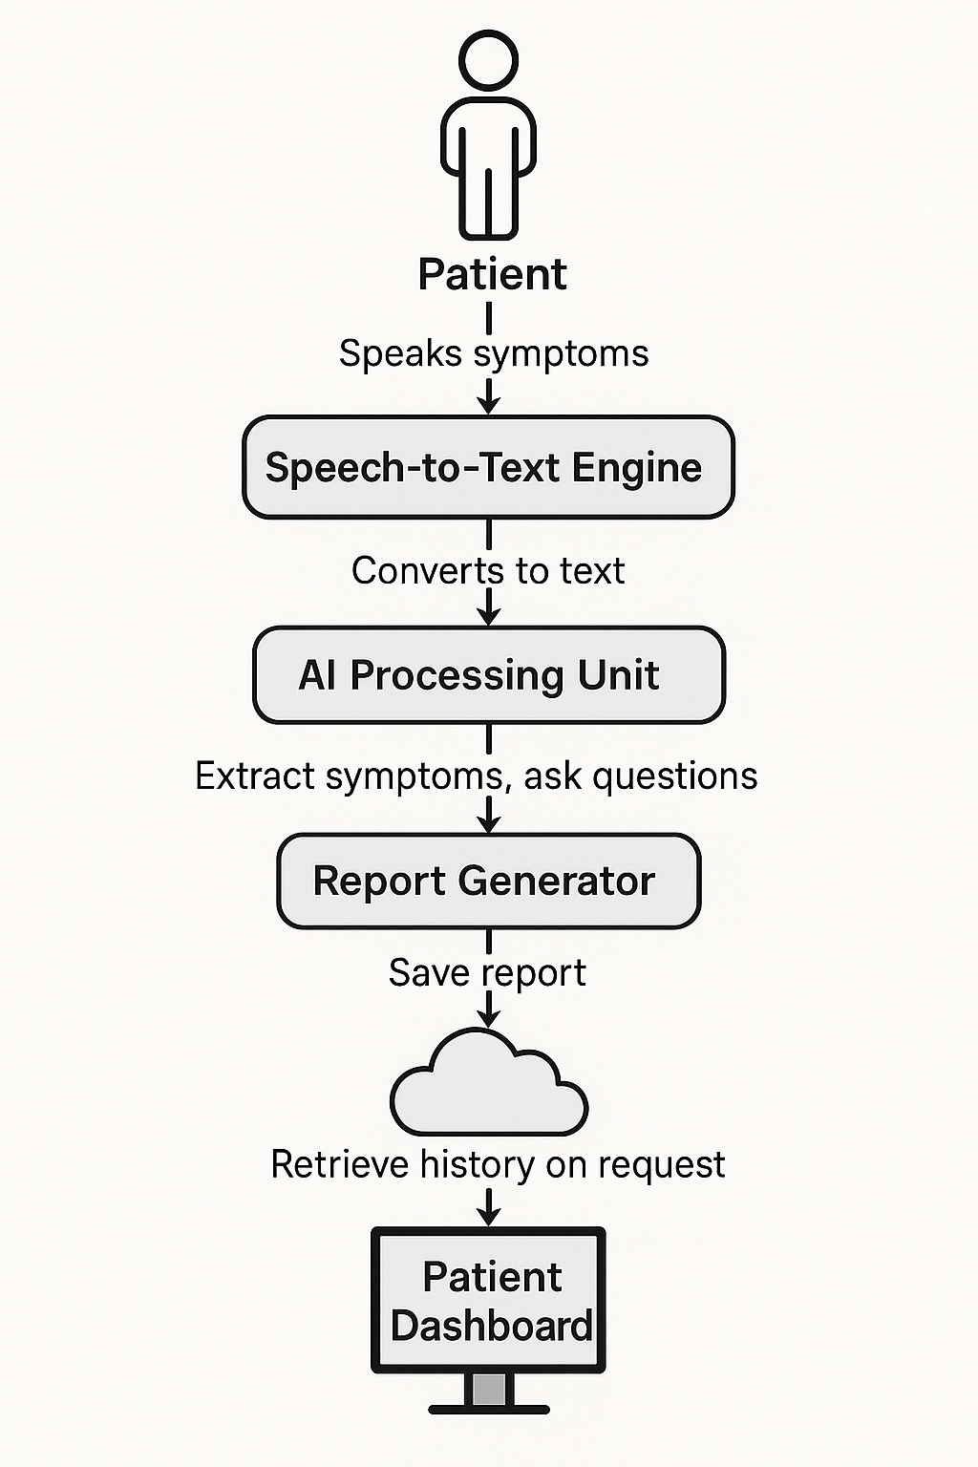
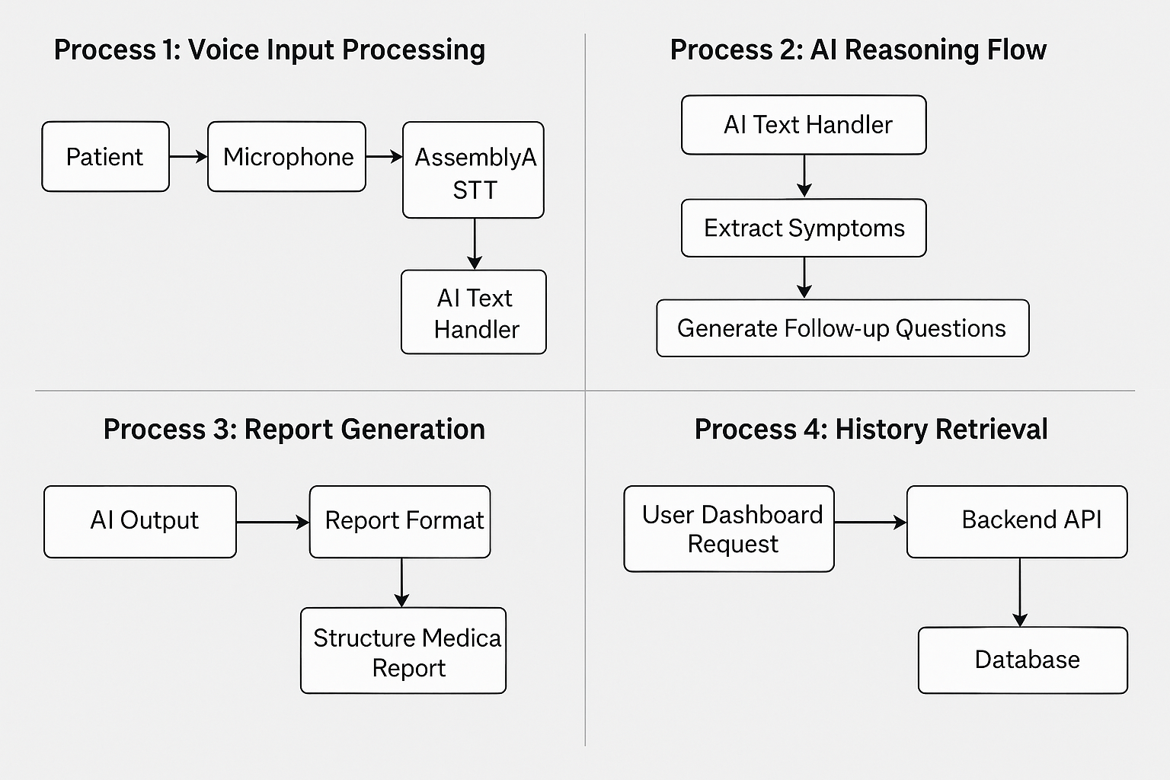

Slide 19
Results
The implemented system successfully performs conversational voice consultations, generates structured medical reports automatically, and securely stores consultation history for future reference.
System Performance Evaluation
Performance testing shows the system provides quick response times, handles multiple consultations efficiently, and significantly reduces consultation effort compared to manual telemedicine workflows.

Slide 20
Conclusion
The proposed AI-driven healthcare framework enhances healthcare accessibility, automates consultation documentation, reduces doctor workload, and offers scalable remote healthcare support, making it suitable for future real-world deployment.

Slide 21
References
Ajami, S., & Bagheri-Tadi, T. (2013). Barriers for adopting electronic health records (EHRs) by physicians. Acta Informatica Medica, 21(2), 129.
2. Al Ghadban, Y., et al. (2023). Transforming Healthcare Education: Harnessing Large Language Models for Frontline Health Worker Capacity Building using Retrieval-Augmented Generation. medRxiv.
3. Andersen, T. O., et al. (2021). Realizing AI in Healthcare: Challenges Appearing in the Wild. Extended Abstracts of the 2021 CHI Conference on Human Factors in Computing Systems.
4. Antoniak, M., et al. (2024). NLP for Maternal Healthcare: Perspectives and Guiding Principles in the Age of LLMs. Proceedings of the 2024 ACM Conference on Fairness, Accountability, and Transparency.

Slide 22
5. Berry, A. B. L., et al. (2017). Creating Conditions for Patients’ Values to Emergent in Clinical Conversations: Perspectives of Health Care Team Members. Proceedings of the 2017 Conference on Designing Interactive Systems.
6. Boersma, P., & Weenink, D. (2023). Praat: doing phonetics by computer. [Online access].
7. Boonstra, A., & Broekhuis, M. (2010). Barriers to the acceptance of electronic medical records by physicians from systematic review to taxonomy and interventions. BMC Health Services Research, 10(1), 231.
8. Brooke, J. (1996). SUS: A 'quick and dirty' usability scale. Usability Evaluation in Industry.
9. Burgess, E. R., et al. (2023). Healthcare AI Treatment Decision Support: Design Principles to Enhance Clinician Adoption and Trust. Proceedings of the 2023 CHI Conference on Human Factors in Computing Systems.
10. Cahyo, L., & Astuti, S. (2023). Early Detection of Health Problems through Artificial Intelligence (Ai) Technology in Hospital Information Management: A Literature Review Study. Journal of Medical and Health Studies, 4, 37–42.

Slide 23
11. Cai, C. J., et al. (2019). "Hello AI": Uncovering the Onboarding Needs of Medical Practitioners for Human-AI Collaborative Decision-Making. Proc. ACM Hum.-Comput. Interact., 3, 24.
12. Cascella, M., et al. (2023). Evaluating the Feasibility of ChatGPT in Healthcare: An Analysis of Multiple Clinical and Research Scenarios. Journal of Medical Systems, 47(1), 33.
13. Chaudhry, B. (2006). Systematic Review: Impact of health information technology on quality, efficiency and costs of medical care. Annals of Internal Medicine, 144(10), 742.
14. Chen, W., & Akay, M. (2011). Developing EMRs in Developing Countries. IEEE Transactions on Information Technology in Biomedicine, 15(1), 62–65.
15. Chen, Z., et al. (2023). MEDITRON-70B: Scaling Medical Pretraining for Large Language Models. arXiv:2311.16079.

